Slide 1
Chapter 11

Slide 2
Objectives

Slide 3
Objectives (cont.)

Slide 4
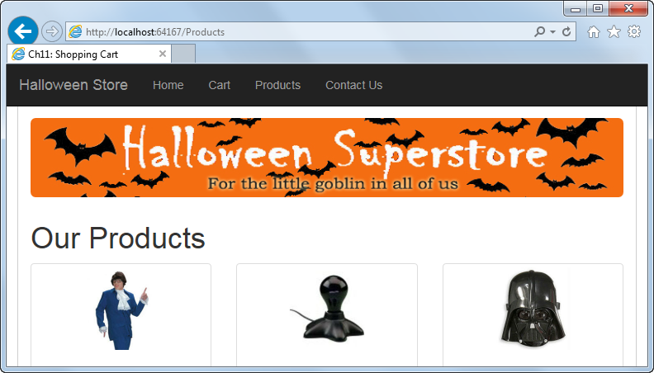
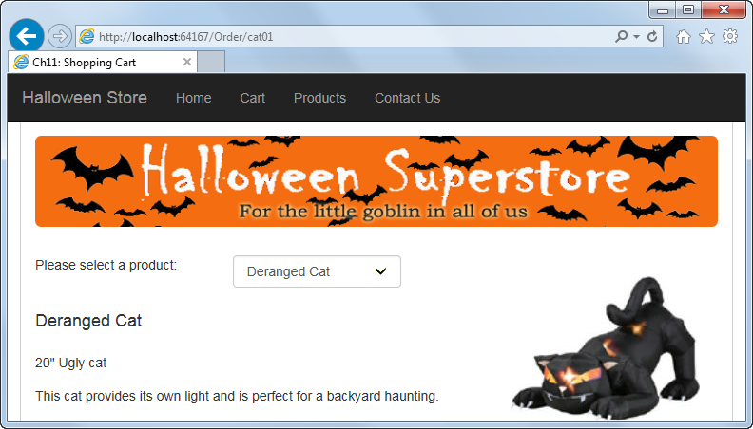
Friendly URLs in a Shopping Cart application

Slide 5
A URL with a query string parameter

Slide 6
Two benefits of friendly URLs

Slide 7
Friendly URLs in the Shopping Cart application and their actual file paths

Slide 8
Two ways to provide friendly URLs in ASP.NET Web Forms

Slide 9
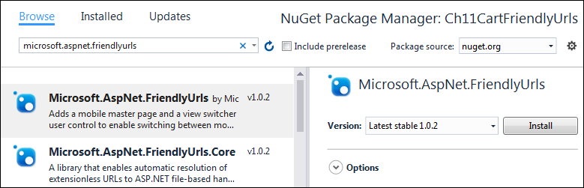
The NuGet Package Manager page for installing FriendlyUrls

Slide 10
The RouteConfig class that’s added to the App_Start folder

Slide 11
The code you must add to the Global.asax file to make FriendlyUrls work

Slide 12
The default functionality of the FriendlyUrls feature

Slide 13
A using directive for the FriendlyUrls namespace

Slide 14
A statement that creates a friendly URL

Slide 15
Three ways to code a file path that’s relative to the root directory

Slide 16
Some of the methods of the WebFormsFriendlyUrlResolver class

Slide 17
Code that keeps the application from changing to the mobile master page

Slide 18
A RegisterRoutes method that uses the custom resolver

Slide 19
Some of the aspx code for the navbar on the master page

Slide 20
The aspx code for the Go to Cart button on the Order page

Slide 21
The aspx code for the Repeater control on the Products page

Slide 22
The aspx code for the drop-down list on the Order page

Slide 23
Some of the C# code for the Order page

Slide 24
Some of the C# code for the Order page (cont.)

Slide 25
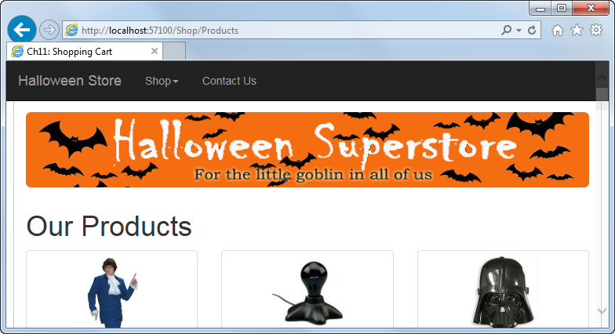
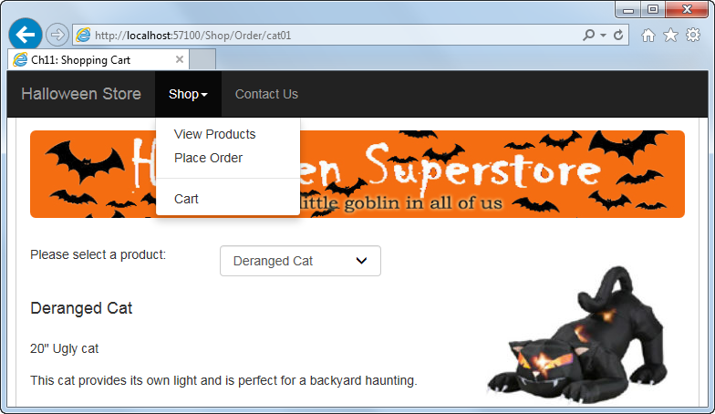
Friendly URLs in a Shopping Cart application that uses ASP.NET routing

Slide 26
Friendly URLs in the Shopping Cart application and their actual file paths

Slide 27
Common parameters of the MapPageRoute method

Slide 28
A RegisterRoutes method with custom routes

Slide 29
How to retrieve a route parameter

Slide 30
How to use a route parameter as the parameter for a SQL data source

Slide 31
Some of the aspx code for the navbar on the master page

Slide 32
The aspx code for the Go to Cart button on the Order page

Slide 33
Some of the aspx code for the Repeater control on the Products page

Slide 34
Some of the C# code for the Order page

Slide 35
Some of the C# code for the Order page (cont.)

Slide 36
A RegisterRoutes method for FriendlyUrls and ASP.NET routing

Slide 37
C# code that retrieves a URL parameter

Slide 38
Three URLs that map to Order.aspx but are handled differently

Slide 39
A custom resolver that causes ASP.NET routing to handle the third URL

Slide 40
A custom resolver that causes ASP.NET routing to handle all URLs

Slide 41
Some of the C# code for the Order page

Slide 42
Some of the C# code for the Order page (cont.)

Slide 43
The overridden ConvertToFriendlyUrl method in the custom resolver

Slide 44
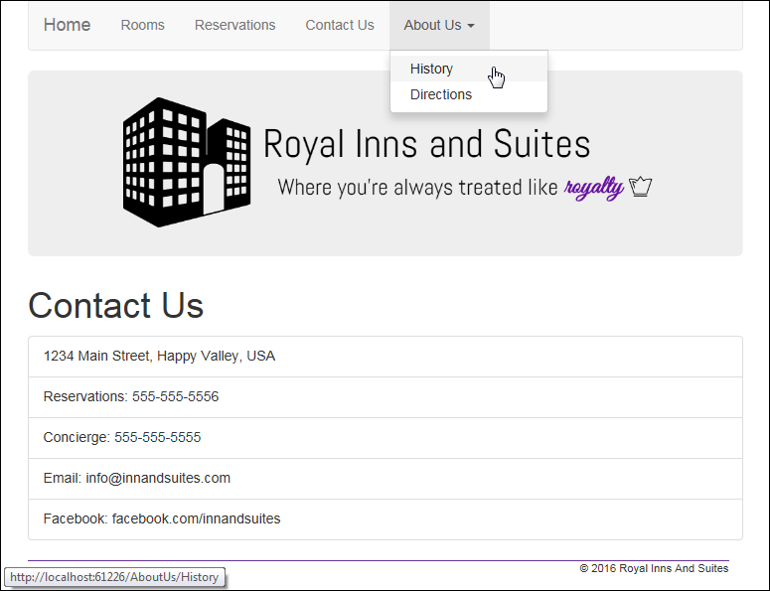
Extra 11-1 Add friendly URLs to the Reservation application

